Slide 1

Python Intro
ReDI NRW

Slide 2
Agenda
Teachers and Students introduction
Course and tools introduction
Python introduction

Slide 3
Teachers and students
Introduce yourselves ☺

Slide 4
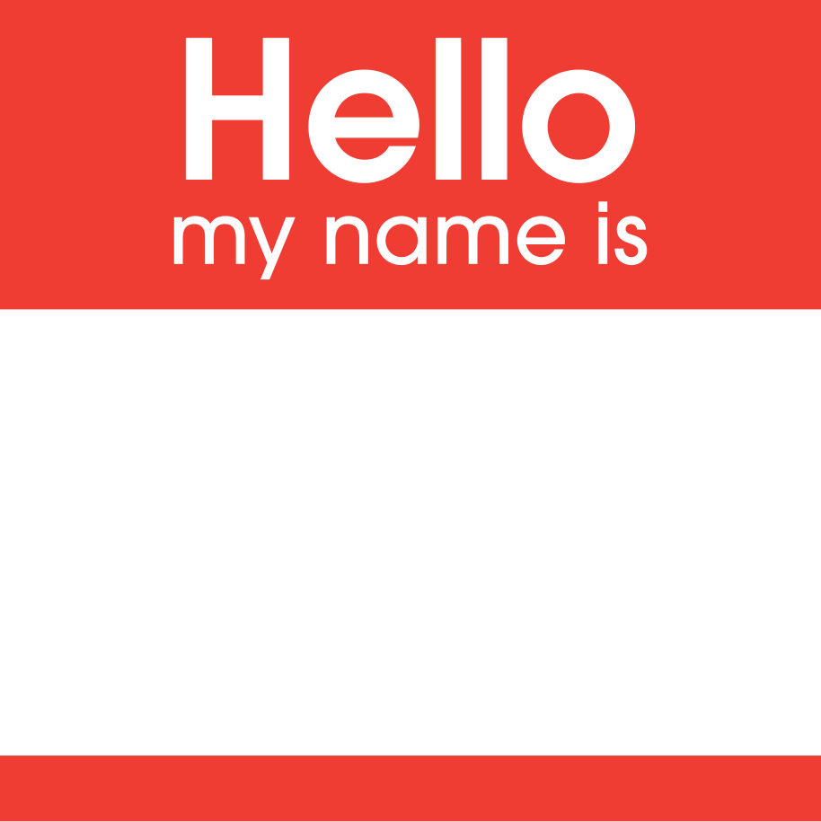
Name Why this course? What do I expect?

Slide 5

Your thoughts…
Are computers smart?
If not: What/Who makes them appear smart?
Why use a computer then?
What would you like to be able to make a computer do?
Beside instructing a computer: Why would you want to learn a programming language?

Slide 6
Course intro

Slide 7
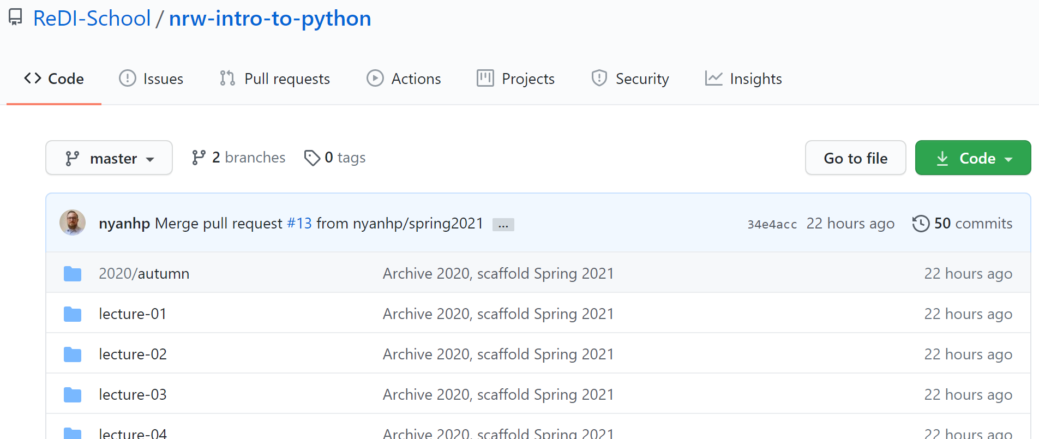
Course Content
https://github.com/redi-school/nrw-intro-to-python

Slide 8
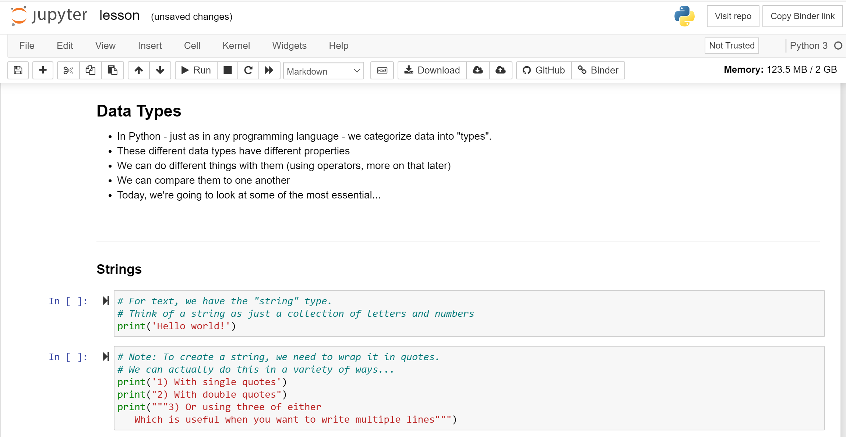
Accessing content without local installation
https://mybinder.org/v2/gh/redi-school/nrw-intro-to-python/HEAD

Slide 9
What will we learn?
Basic concepts of programming (Python)
How to think like a programmer (Programmers' logical thinking)
How to teach yourself and learn programming

Slide 10
What Tools will we use
Python
Visual Studio Code

Slide 11
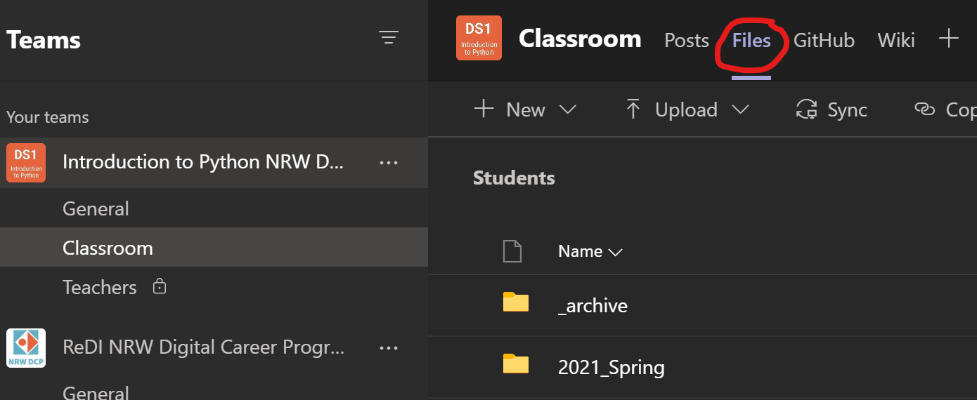
Teams
Join online classes
Find course contents
Find homework
Upload homework
Discuss with classmates
Ask the teachers

Slide 12
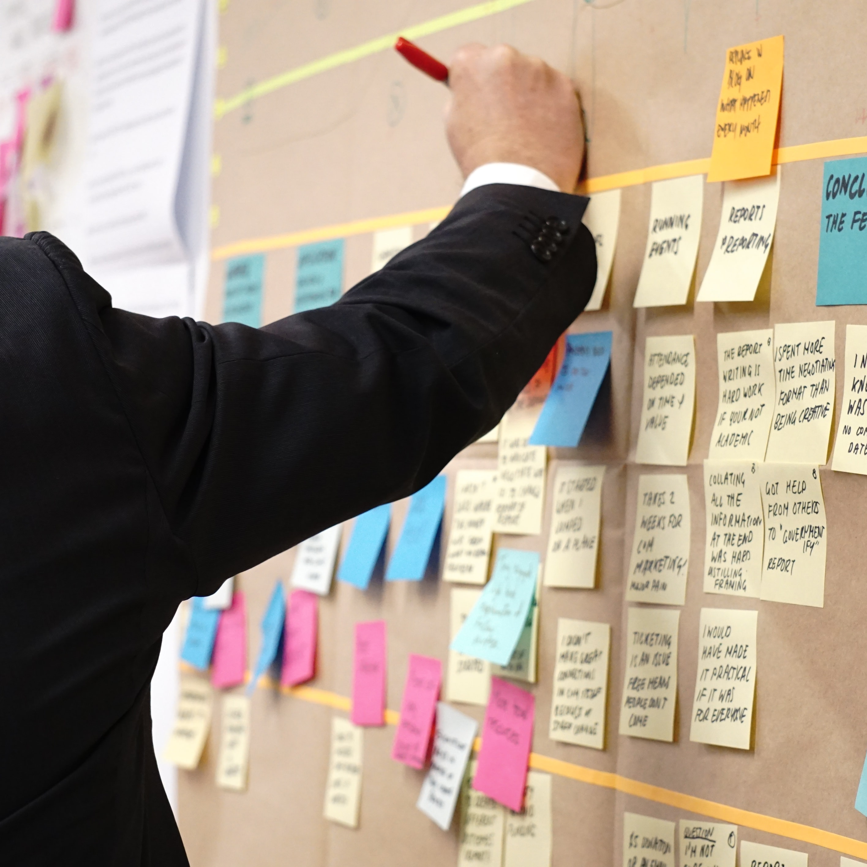
Final project
Solve a data science problem
We will prepare you in the upcoming lessons

Slide 13
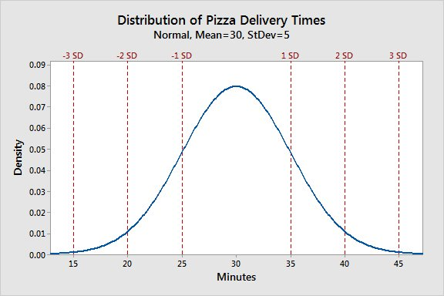
In a few Months?!

Slide 14
Python Introduction

Slide 15

A little history
First released 1991
Current version 3.11
Designed by Guido van Rossum
Name pays hommage to Monty Python

Slide 16

What is Python?
All-purpose
Web Development
APIs
Games
Data science
…
Object-oriented
Easy to learn

Slide 17
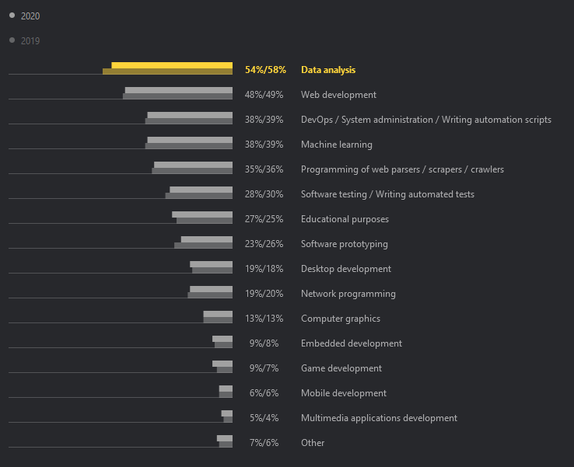
You can build almost anything with Python! Source: JetBrains Python Survey 2020

Slide 18
Python features
„Batteries included“
Many libraries included (Tool box)
Cross-platform
Open-source
Huge ecosystem of libraries
pip (pip installs packages) is used to connect to repositories
Libraries extend functionality greatly
Some libraries will be part of this course: NumPy, pandas, MatPlotLib, FastAPI
Well-structured, (mostly) beautiful code

Slide 19
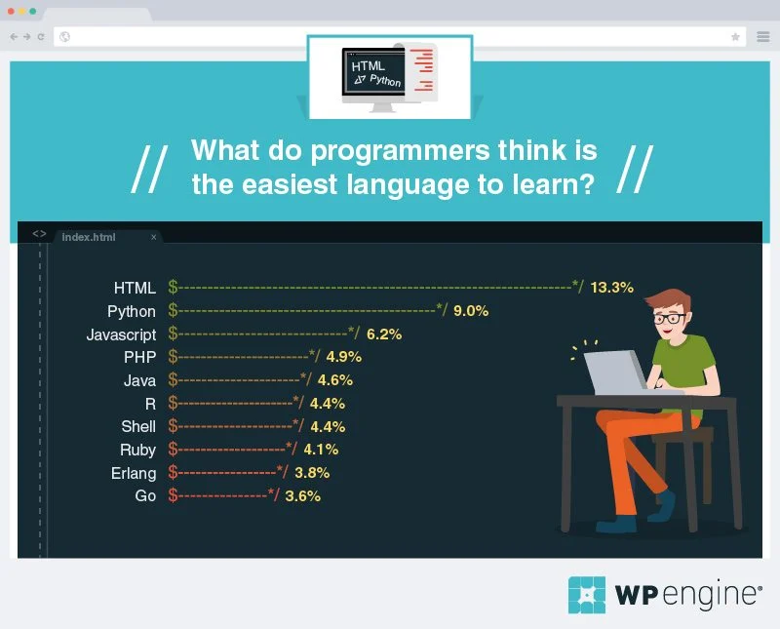
Python is considered easy to learn. Source: 2017 WP Engine Survey

Slide 20

Writing code in Python is easy compared to many other programming languages! Source: xkcd

Slide 21
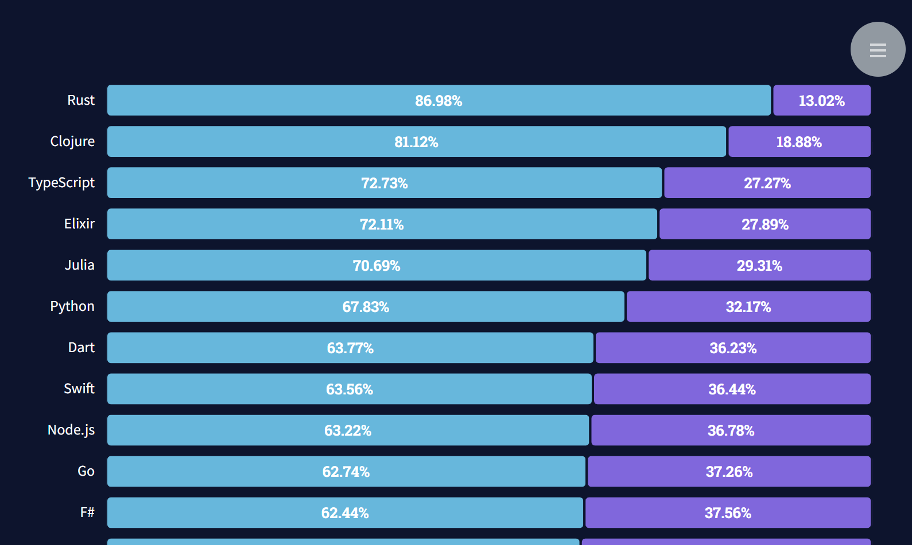
Python is highly appreciated among software developers! Source: 2021 StackOverflow Developer Survey

Slide 22
“Python where we can, C++ where we must”
Google Engineering Team

Slide 23
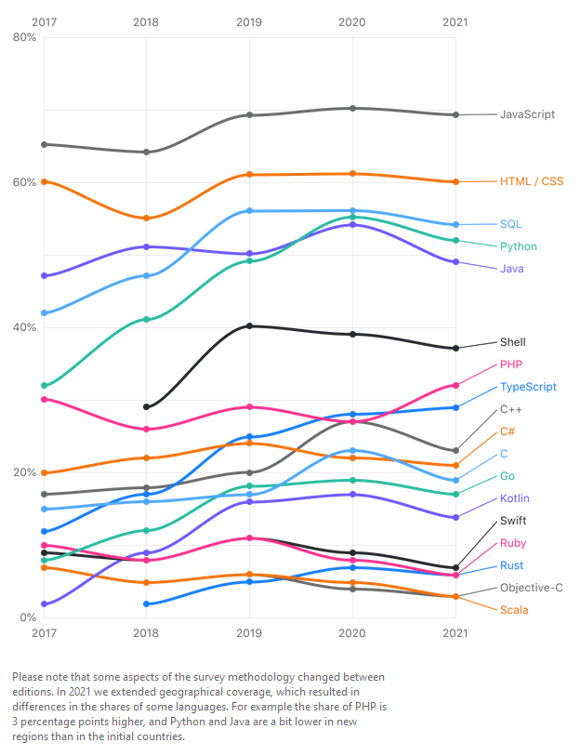
Python is a frequently used programming language! Source: JetBrains DevEcosystem Survey 2021

Slide 24
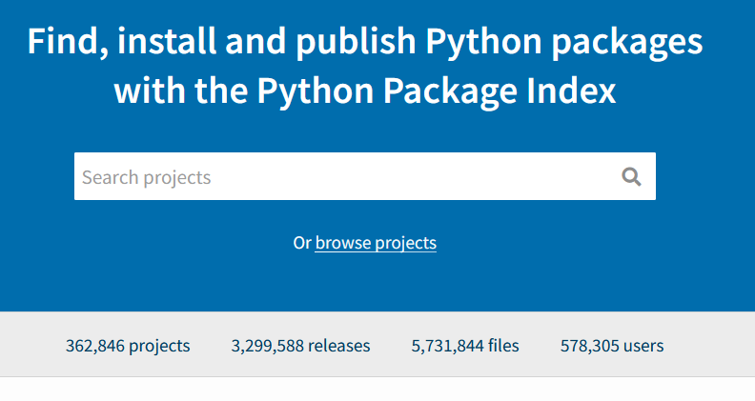
Community
Extended by open-source community
Core components change through PEP
Python Enhancement Proposal
PEP8 https://pep8.org – Style Guide
PEP20 https://pep20.org – the Zen of Python
Massive amount of additional functionality provided through additional packages

Slide 25
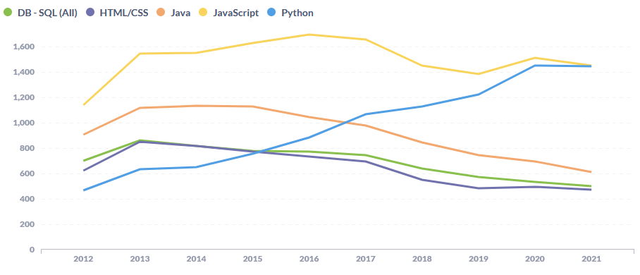
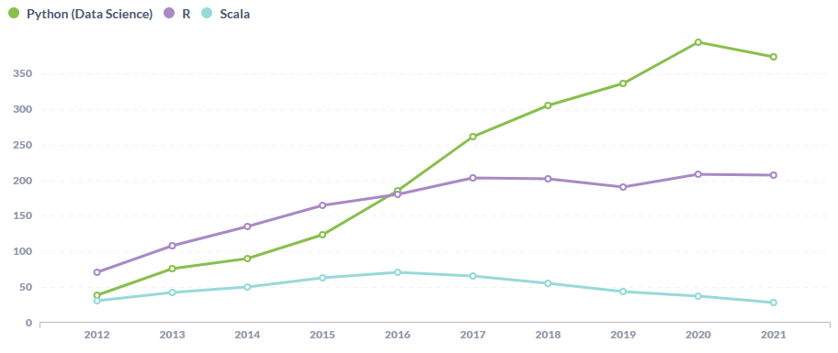
Python Community is extremely active and happy to help! Source: Questions on StackOverflow (https://towardsdatascience.com/popularity-ranking-of-programming-languages-72bcf697ea20)

Slide 26
(An extract of) The Zen of Python
Notes:
Examples for each Zen can be found here: https://github.com/hblanks/zen-of-python-by-example/blob/master/pep20_by_example.py

Slide 27
Beautiful is better than ugly

Slide 28
Simple is better than complex

Slide 29
Complex is better than complicated
Notes:
Complex: Having many related parts
Complicated: Many parts interacting in ways that are difficult to understand.
Requirements may make code complex. Poor decisions (and poor language design) make code complicated.
To keep complex things from getting complicated, try to separate concerns

Slide 30
Flat is better than nested

Slide 31
Readability counts

Slide 32
If the implementation is hard to explain, it’s a bad idea.

Slide 33
Homework
https://forms.office.com/Pages/ResponsePage.aspx?id=Opo3HBpIjEGHV5chJ_yqfyBpv-NKSRVPrnCFDfkSECNUNjFQMDlQQUxLQUwwVVQzS0FPUjZKOVhWViQlQCN0PWcu
Will be graded on Monday March 22nd, so please submit until 16:00 on the 22nd !

